Slide 1
How Sweet is the Terminal?
Terminal 101 Day 1
3.1

Slide 2
Class Objectives
By the end of today’s class, you will be able to:
Explain why the command line is important for IT and security professionals.
Use commands like ls, cd, mkdir, touch, cp, mv, rm, rmdir, and cat for basic file navigation.
Navigate deeply nested folder structures using relative and absolute file paths.
Use commands like head, tail, more, and less to preview files in the command line.
Combine the above commands in sequence to accomplish relevant IT tasks.

Slide 3
Why the Terminal Matters

Slide 4

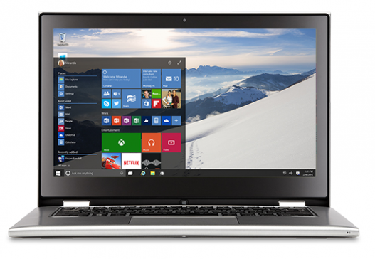
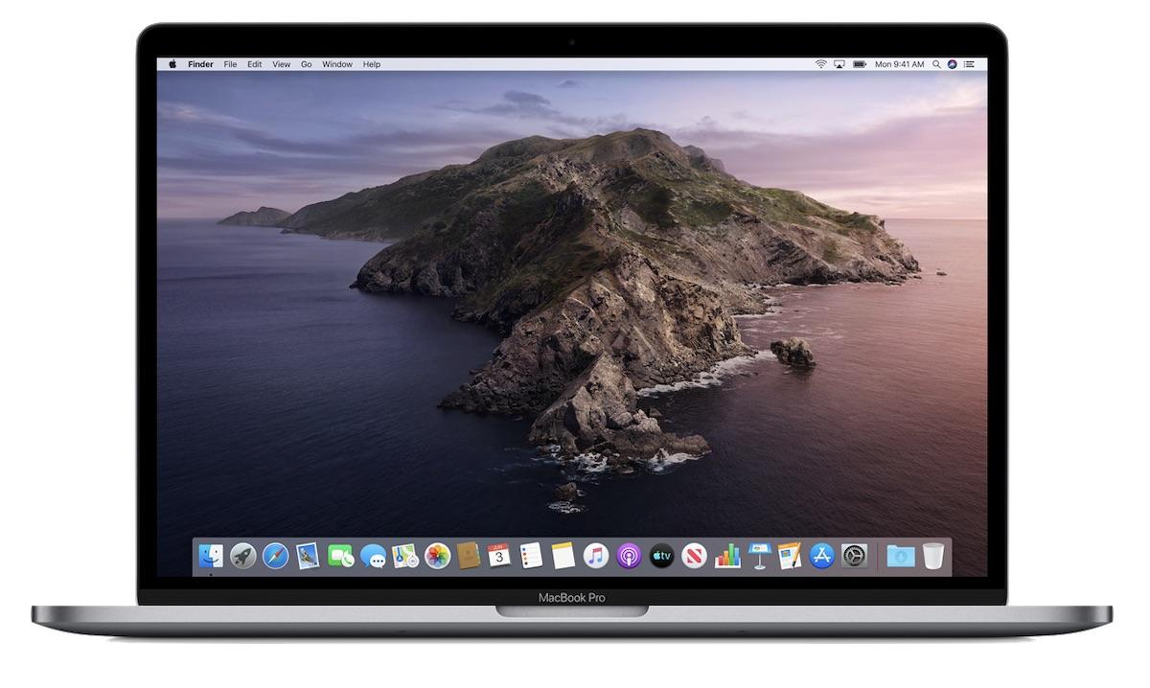
Graphical User Interfaces
We are used to Graphical User Interfaces (GUIs), with their familiar icons, windows, buttons, and mouse pointers.
Mac
PC
(MacOS; Windows)

Slide 5

What is the Command Line?
Command line users don’t directly interact with icons and buttons on the screen.
Users complete tasks on their computer by issuing commands with a line or lines of text in the terminal.
Ryans-MacBook-Pro-2:~ ryan$ cd Documents
Ryans-MacBook-Pro-2:Documents ryan$ ls
Assessment.docx Day-1-Notes.docx
Project-1 Homework-1.docx
Project-2 Homework-2.docx
Ryans-MacBook-Pro-2:~ ryan$ cd Documents/Project-1
Ryans-MacBook-Pro-2:Project-1 ryan$ ls
Assessment.docx Presentation Notes.docx Report.docx
Ryans-MacBook-Pro-2:Project-1 ryan$ open Report.docx
For example:
Rather than clicking on a file to open it, we can type a command to open it.

Slide 6

The Command Line
Today, we will complete common computer tasks.
But rather than using our computer’s GUI, we will use the command line.

Slide 7
Raise a Fist: If you’ve never worked with the command line and barely know what it is.
Raise a Five: If you work with the command line on a daily basis.
Raise One, Two, Three or Four: If you fall somewhere in between.

Slide 8
For those who have used the command line: where have you used it and what for?

Slide 9

Why the Command Line?

Slide 10
Why the Command Line?
Using the command line is a critical skill. At different times, it may be:
The only way to achieve a desired outcome.
The fastest way to achieve a desired outcome.
The most flexible way to achieve a desired outcome.

Slide 11

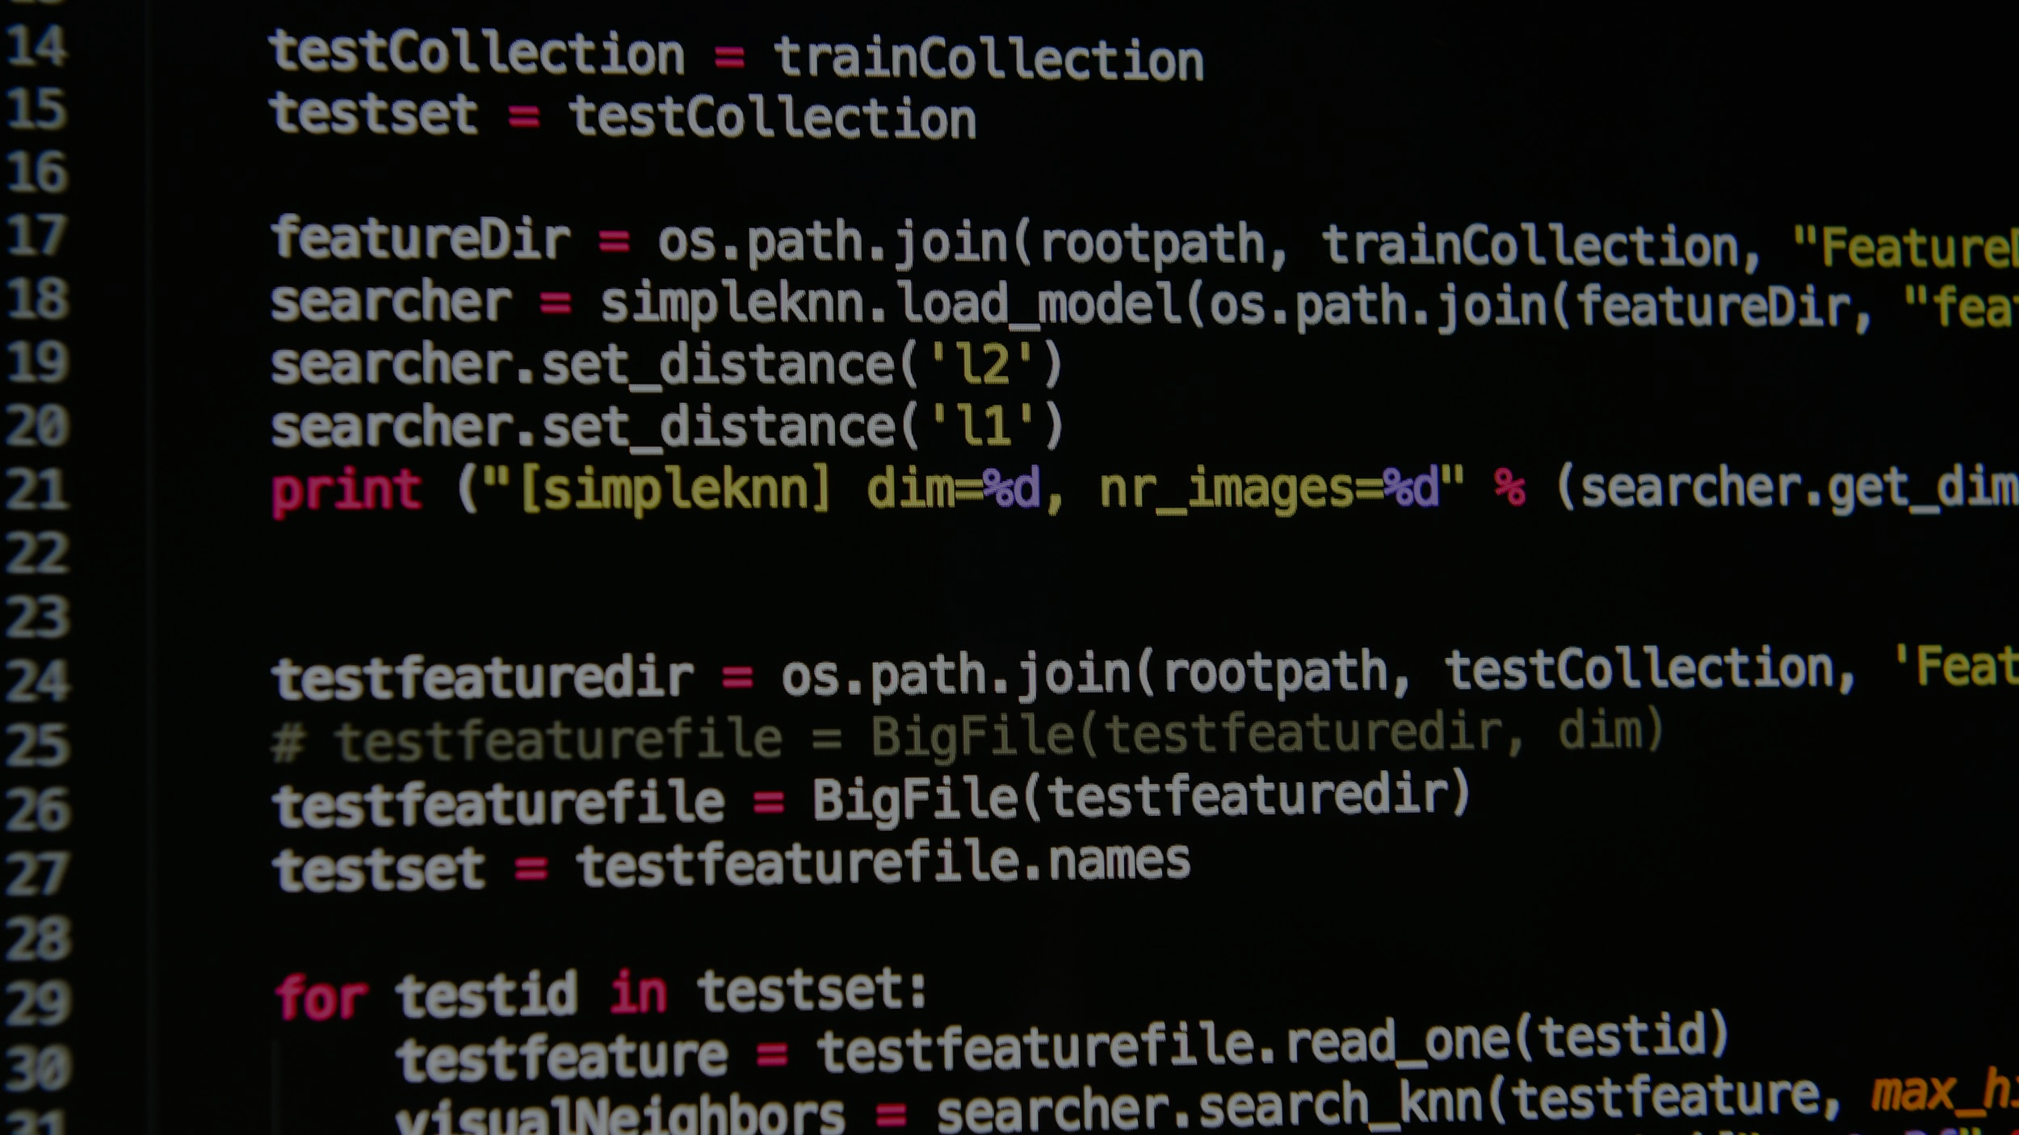
Why the Command Line?
01
The only way to achieve a desired outcome.
You may have to work with systems and tools that have no GUI interface.
For example:
You need to configure a system that does not have a GUI. The command line is your only mode for configuration.

Slide 12


Why the Command Line?
02
The fastest way to achieve a desired outcome.
The command line has tools that can speed up a task.
For example:
You can develop a script on the command line to automate and repeat a task.

Slide 13

Why the Command Line?
03
The most flexible way to achieve a desired outcome.
Working with a GUI may be the most familiar, but working directly with the command line provides greater control.
For example:
You can output logs to specific locations, combine files in unique ways, and string together commands with more flexibility.

Slide 14
Words to the Wise
A few things to remember.
The best way to learn the command line is to use it.
This week will be heavily focused on hands-on activities.
Take notes during each demo and try your best on activities.
Remember: Practice makes perfect!
bootcampspot.instructure.com

Slide 15
Virtual Machines

Slide 16



Physical Machines
To most people, a computer means a physical laptop or desktop computer, made up of hardware, such as:
Monitors
Graphic Cards
Hard Drives
etc.

Slide 17
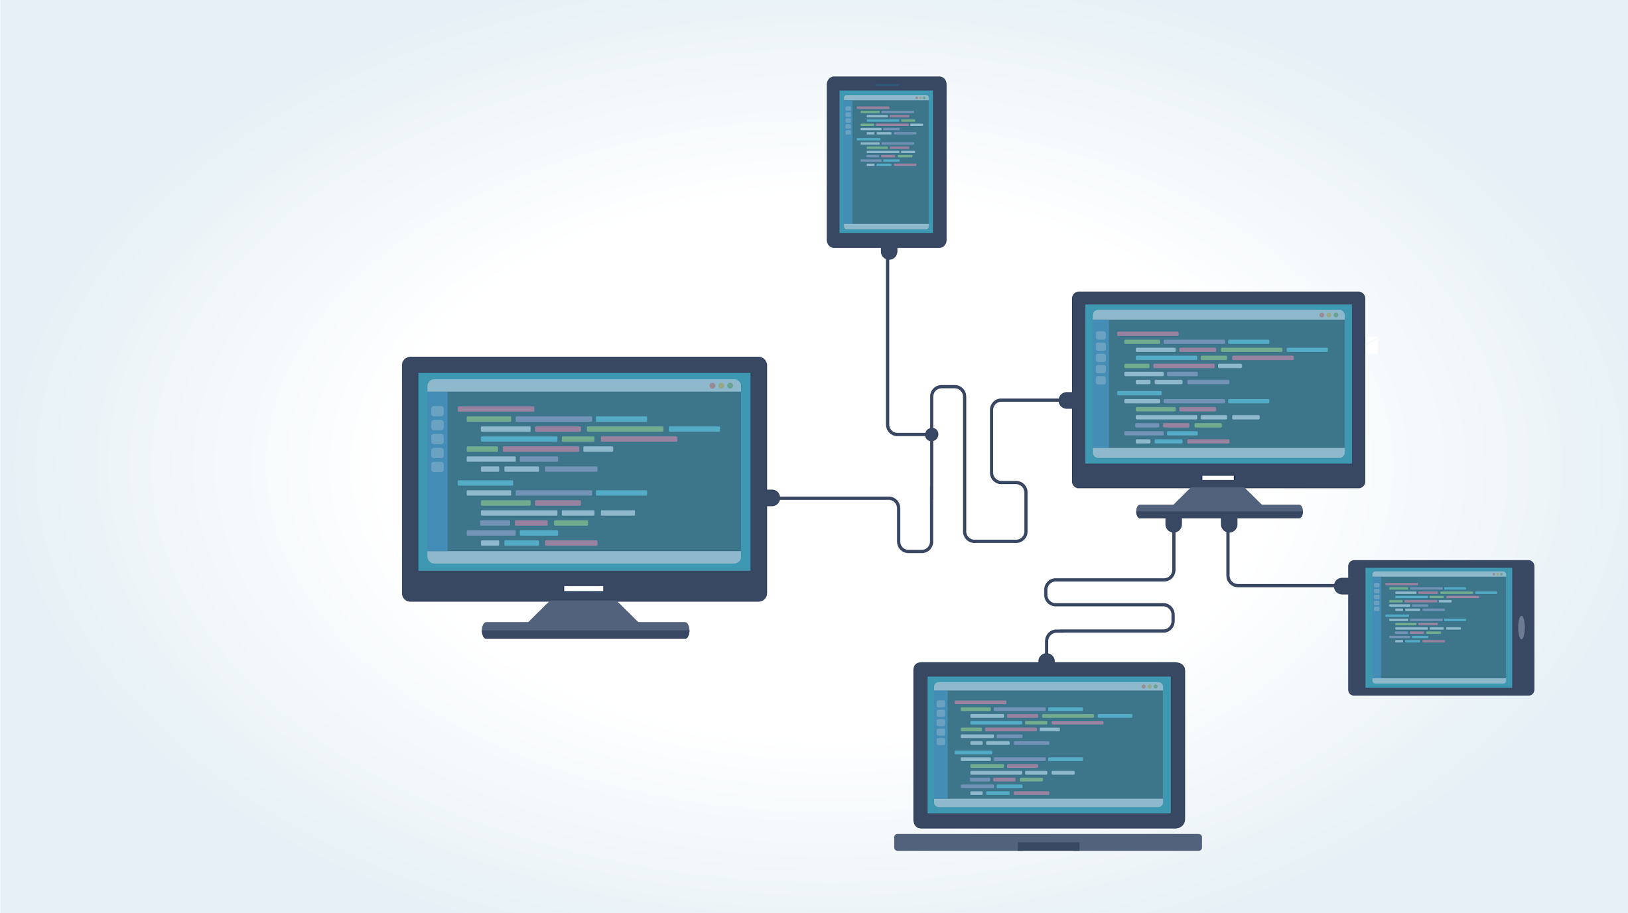
Virtual Machines
As we learn how to work on the command line, we will be using a new tool called virtual machines.

Slide 18

Virtual Machines
Virtual machines are programs that simulate entire computers.
Virtual machines (VMs) can operate as entirely different computers than the one they are running on.
We can run many different VMs on a single physical computer.

Slide 19

Physical vs. Virtual Machines
Virtual
vs.
Physical
Easy and inexpensive (or free) to set up.
Easily distributed. In this class, we’ll be distributing VMs so each student is running the exact same setup.
Multiple VMs can be placed on a single physical machine.
Typically more efficient because they have direct access to hardware components.

Slide 20
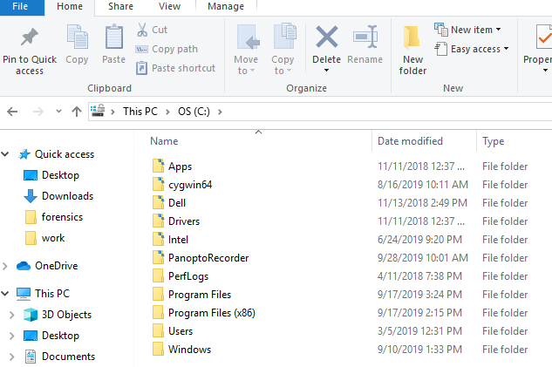
Working on the Command Line
Within this Windows Explorer, we can complete the following tasks:
View current directory location.
Navigate through directories and files.
Create new folders.
In the next demo, we’ll complete these tasks on the command line.

Slide 21
Basic Terminal Commands

Slide 22
Basic Commands
In the next demo, we’ll cover the following commands:
pwd | Display the current working directory (print working directory).
ls | List directories and files in the current directory.
cd | Navigate into a directory (change directory).
mkdir | Make a directory.
rmdir | Remove a directory.
touch | Create an empty file.
rm | Remove a file.
clear | Clear the terminal history of a page.

Slide 23
Demonstration Scenario
We are security analysts at ACME Corp. Our manager assigned us several investigations and gave us a computer in the evidence room. We are asked to:
01
02
03
Create several directories to organize our investigations: Case1 and Case2.
Put our directories in the already existing folder security_evidence.
Put an empty file in the Case1 folder titled case1_evidence.

Slide 24
Demonstration Review
What does each of the commands do?
pwd
ls
cd
mkdir
rmdir
touch
rm
clear

Slide 25
Demonstration Review
What does each of the commands do?
pwd | Display the current working directory (print working directory)
ls | List directories and files in the current directory
cd | Navigate into a directory (change directory)
mkdir | Make a directory
rmdir | Remove a directory
touch | Create an empty file
rm | Remove a file
clear | Clear the terminal history of a page

Slide 26
Activity: Take Five and Practice the Command Line
In this activity, you are a security analyst at Wonka Corp. Wonka Corp believes an employee is selling secret recipes. You must create evidence directories for email, logs, and web_access to organize your investigation of the rogue employee.
7 minutes

Slide 28
Command Line Review
Completing this activity required the following steps:
Make a directory.
Navigate into the directory.
Print the working directory.
Create empty files.
Delete files.
List files.
Clear the terminal window.

Slide 29
File Paths

Slide 30
File Paths
A file path is the unique location in the directory where a file is located.
The cat.jpg image file is located in the my_images directory, which is in the desktop directory, which is in the root directory.
/root/desktop/my_images/cat.jpg
The directory path is: /root/desktop/my_images/.
The file is an image called: cat.jpg.

Slide 31
File Paths in IT
You are a security administrator and need to access a network log for an investigation.
You might ask the network team for the location or path of the file. The network team would provide you with a file path such as:
/root/var/logfile1.txt

Slide 32
There are two types of file paths: absolute paths and relative paths.

Slide 33

Absolute Paths
root/Desktop/Sallysfiles/textfiles/Sallyfile.txt
An absolute path indicates the location of a file regardless of your current location in the file directory.
If you’re in the Applications directory and need to access a file in the Desktop directory, you can use an absolute path to get the file without navigating to the Desktop directory.

Slide 34
Absolute Paths
We want to access a file located at:
/root/Desktop/Sallysfiles/textfiles/Sallyfile.txt
If we are located in a different directory, such as,
/root/rootfiles/file_logs/
We can use the absolute path,
/root/Desktop/Sallysfiles/textfiles/Sallyfile.txt
To access
Sallyfile.txt

Slide 35
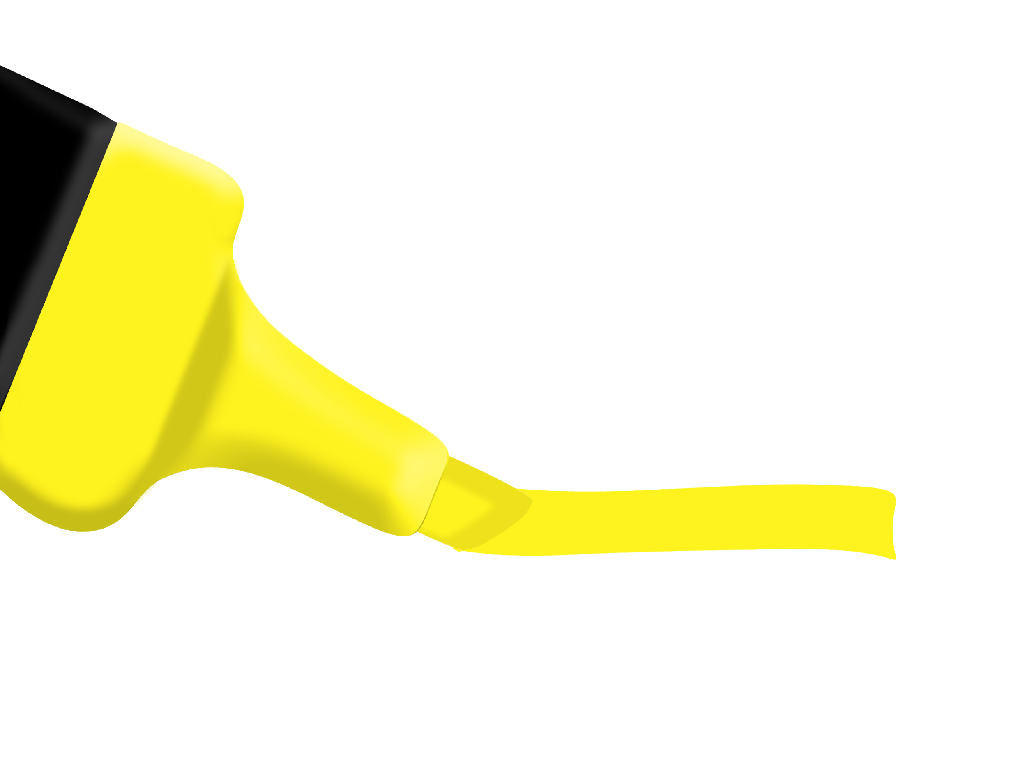
Relative Paths
/Sallysfiles/textfiles/Sallyfile.txt
A relative path, starts at your current location in the directory and doesn't require typing out the root directory.
If you need to access a file in the Desktop directory and are already in Desktop , create a path from your current point.
In the above example, the user is in the Desktop directory, so root/Desktop/ is assumed and not written.

Slide 36
File Paths on the Command Line
Relative and absolute paths function as helpful shortcuts on the command line.
cd Desktop
cd textfiles
cd Sallysfiles
cd Desktop/textfiles/Sallysfiles/

Slide 37
Demonstration Scenario
Our manager at ACME Corp. needs us to create several additional evidence files for our investigation. They provided the following instructions:
01
Navigate to the directory /home/instructor/Cybersecurity-Lesson-Plans/03-Terminal/instructor/pathnav_demonstration/
security_evidence/Case2/. Create an empty file called case2_evidence.
02
Navigate to the directory Case1 and create an empty file called Web_logs.
03
Navigate back to the root folder.

Slide 38
Relative vs. Absolute Paths and the cp and mv Commands

Slide 39
Copying and Moving Files

Slide 40
Copying Files
Security and IT professionals often copy files from one location to another.
For example:
You’re asked to make a copy of a log file and put it in a separate evidence folder.
cp (copy) creates a copy of the file and places it in a specified location.
The original file stays in its original location.
The original file remains. A copy is created in the new location, where it can be edited as needed.

Slide 41
Moving Files
Security and IT professionals often move files from one location to another.
For example:
An image file is accidentally placed in the email directory. You have to move the file out of the email directory and into the correct image directory.
mv (move), relocates the file from its current location to a new, specified location.
Unlike cp, the original file doesn’t remain.
The file is moved into the new location. (Similar to “cut and paste.”)

Slide 42
cp and mv Syntax
cp and mv have a similar syntax.
mv cat.jpg /dirA
mv dirA/dirB/dirC/cat.jpg /dirA/dirB
This command moves the file cat.jpg into the directory dirA.
The <file> or <location> can be indicated with an absolute or relative path if the file is not in your current location.
This command moves the file cat.jpg from the dirC directory, over to the dirB directory.

Slide 43

Copy and Move Demo Scenario
Our manager made a mistake. They realize they only need web activity for Case 2.
We need to move the Web_logs file from the Case1 directory to the Case2 directory.
After we move the file into the Case2 directory, we must
make a copy of the Web_logs file and
put it in the security_evidence folder.

Slide 44
Let’s Review
What does each of these do?
file path
absolute path
relative path
cp
mv

Slide 45
Let’s Review
What does each of these do?
file path | Identifies a unique location in a file system.
absolute path
relative path
cp
mv

Slide 46
Let’s Review
What does each of these do?
file path | Identifies a unique location in a file system.
absolute path | Starts the root of the file system.
relative path | a path that begins from the current directory
cp
mv | to move files

Slide 47
Let’s Review
What does each of these do?
file path | Identifies a unique location in a file system.
absolute path | Starts the root of the file system.
relative path | Begins from the current directory.
cp
mv | to move files

Slide 48
Let’s Review
What does each of these do?
file path | Identifies a unique location in a file system.
absolute path | Starts the root of the file system.
relative path | Begins from the current directory.
cp | Copies files.
mv | to move files

Slide 49
Let’s Review
What does each of these do?
file path | Identifies a unique location in a file system.
absolute path | Starts the root of the file system.
relative path | Begins from the current directory.
cp | Copies files.
mv | Moves files.

Slide 50
Activity: Finding Your Milky Way
You continue in your role as security analyst at Wonka Corp. Your manager now believes there is a second employee working with Slugworth Corp.
To continue the investigation, you’ve been asked to create an additional directory, and copy and move several of the evidence files.
15 minutes

Slide 52
Finding Your Milky Way Review
Completing this activity requires the following steps:
Make an additional directory.
Use the move command with an absolute path.
Use the copy command with an absolute path.
Navigate to the directories with absolute or relative paths.
Confirm the files are moved and copied correctly.

Slide 53
Finding Your Milky Way Review
To move email_evidence from Internal_Investigation_Employee_A to Internal_Investigation_Employee_B
mv/home/sysadmin/Cybersecurity-Lesson-Plans/03-Terminal/student/take_5/Internal_Investigation_Employee_A/email_evidence /home/sysadmin/Cybersecurity-Lesson-Plans/03-Terminal/student/take_5/Internal_Investigation_Employee_B/

Slide 54
Finding Your Milky Way Review
To copy log_evidence from Internal_Investigation_Employee_A to Internal_Investigation_Employee_B
cp/home/sysadmin/Cybersecurity-Lesson-Plans/03-Terminal/student/take_5/Internal_Investigation_Employee_A/log_evidence /home/sysadmin/Cybersecurity-Lesson-Plans/03-Terminal/student/take_5/Internal_Investigation_Employee_B/

Slide 56
Preview Commands

Slide 57
Previewing Files
Security and IT professionals often need to preview the contents of a file.
For example:
A security administrator needs to preview the top 10 lines of an email file to figure out who it was sent to.
A network administrator needs to preview the bottom of a log file to see the last timestamp captured.
+

Slide 58
More Less Head and Tail
To preview and scroll through a whole file, use the more or less commands.
more | View a file one page at a time. Space bar moves you to the next page.
less | Similar to more, but it allows you to scroll up and down a file.
To preview a file by a certain number of lines, use the head or tail commands.
head | Displays the top 10 lines of a file.
tail | Displays the bottom 10 lines of a file.

Slide 59
Modifying the Preview
head and tail preview 10 lines by default. This number can be changed easily.
The syntax for head is head -number file.
For example:
head-50 logfile.txt shows the top 50 lines in logfile.txt.
The same syntax applies for the tail command.

Slide 60
Demo Scenario
At ACME Corp, we’ve been asked to examine several potential evidence files.
Our manager provided a directory, evidence_directory, containing four files:
File1, File2, File3, File4.
These files were pulled from a secret computer at Wonka. They should be access logs showing who has logged in to that computer.
We’ll use the preview commands to determine which files are actually access logs.
Once we determine which are access logs, we’ll document the last timestamp in the file.

Slide 61
Let’s Review
What does each command do?
more
less
head
tail
-number

Slide 62
Let’s Review
What does each command do?
more | View a file page-by-page. Space bar moves you to the next page.
less | Similar to more, but allows you to scroll up and down a file.
head | Previews the top 10 lines of a file.
tail | Previews the bottom 10 lines of a file.
-number | Added after head or tail to change the number of lines previewed.

Slide 63
Activity: Oh Henry, What Did You Do?
You continue in your role as security analyst at Wonka Corp.
Your manager identified two employees who may be working with Slugworth—Henry and Ruth—and quickly pulled some files from their computers.
You must preview the files to determine which have readable text data that can be used for analysis.
5 Minutes

Slide 65
Oh Henry Review
Completing this activity required the following steps:
Using the more, less, and head commands to preview content from several files.
Using the tail command to view data at the bottom of a file.
Using the move command to rename a file.

Slide 66
Data Streams and the cat Command

Slide 67

The cat Command
Security and IT professionals often have to combine files.
For example:
A security professional needs to combine
several of the same type of log file into a
single log file.
We can use the cat command to complete this task.

Slide 68
The cat Command
cat (concatenate): combines files and displays the results.
To combine 1.txt and 2.txt , run cat 1.txt 2.txt .
This displays the combined results of 1.txt and 2.txt — but doesn't save the results beyond the command line.
1.txt:
A B C D
2.txt:
E F G H
A B C D
E F G H
cat 1.txt 2.txt

Slide 69

This command does not save the results.
To save results of the cat command, you have to redirect the data stream.

Slide 70

Data Streams
A data stream describes channels of data as they are processed and moved through a system.
Data streams are used to move data from one process or program to another.

Slide 71

stdin and stdout
The most common data streams are stdin and stdout, pronounced
“standard in” and “standard out”.
Input data is usually the argument given to the program. Output data is the information returned by the program when the command succeeds.
Input data is streamed using the data stream stdin.
Output data is streamed using the data stream stdout.
program
stdin from keyboard
>_
stdout to display

Slide 72
Back to Saving Results with cat
To save the results of cat, you have to use either > or >>.
> overwrites a file
>>
writes or appends to a file
or

Slide 73
cat with >
cat 1.txt 2.txt > combined_1&2.txt
The above command will combine two separate files, 1.txt and 2.txt, into a single file called combined_1&2.txt.
If combined_1&2.txt already exists, it will overwrite the file with the combined data from 1.txt and 2.txt.

Slide 74
cat with >>
cat 3.txt 4.txt >> combined_3&4.txt
The above command will combine two separate files, 3.txt and 4.txt, into a single file called combined_3&4.txt.
If it already exists, it will append to the bottom of the file with the combined data from 3.txt and 4.txt.

Slide 75
cat and Data Streams:
cat 1.txt 2.txt > combined_1&2.txt
cat takes data directly from stdin and directs it to stdout.
1.txt and 2.txt is sent to stdin.
cat is taking stdin, concatenating the data, and sending it to stdout.
The results of combining 1.txt and 2.txt is stdout.
stdout is redirected and written to a file called combined_1&2.txt.

Slide 76
Demonstration Set Up
At ACME Corp, you are asked to combine several evidence log files.
Your manager provided:
Your manager explained:
You are tasked with:
A directory, called Logfile_evidence_ directory containing four files: LogFile1, LogFile2, LogFile3, LogFile4.
Each file has logs from a different day.
That your forensic team will be doing an analysis of these logs. Their job will be easier if you can combine the log files into a single file.
Using the cat command to combine the logs into a single file called
rogue_employee_log_ evidence.

Slide 77
Data Streams and the cat Command

Slide 78
Activity: Internal Investigation: Finding the Kit cat Burglar
You continue in your role as security analyst at Wonka Corp.
Your manager believes Henry and Ruth are sharing secret recipes and collected some files from their computers to help you build your case.
You must analyze this additional data and prepare a combined evidence file for the local authorities.
5 minutes

Slide 80
Lesson Recap

Slide 81
Which command do we use to retrieve a list of all files in a folder?

Slide 82
Which command do we use to retrieve a list of all files in a folder?
ls

Slide 83
Which command do we use to create a folder?

Slide 84
Which command do we use to create a folder?
mkdir

Slide 85
Which command do we use to combine two files?
How do we save the output?

Slide 86
Which command do we use to combine two files?
cat
How do we save the output?
cat {files} >

Slide 87
Questions?

